Slide 1
Managing Data Consistency Among Microservices with Debezium
Justin Chao, Optum
#ossummit
@imjchao

Slide 2

Hi, I’m Justin Chao
Software/DevOps Engineer
Optum, UnitedHealth Group
2nd time attending OSS
linkedin.com/in/justinchao
Notes:
UT Austin

Slide 3
Let’s talk about Microservices
Improved Fault Isolation
Eliminate vendor or technology lock-in
Ease of understanding
Smaller, faster deployments
Scalability
Notes:
Improved fault isolation
Larger applications and systems can remain mostly unaffected by the failure of a single module, through the use of circuit breakers, service meshes, etc.
Eliminate vendor or technology lock-in
Microservices provide the flexibility to try out a new technology stack on an individual service as needed.
There won’t be as many dependency concerns and rolling back changes becomes much easier.
Ease of understanding
With added simplicity, developers can better understand the functionality of a service, in context of business domains and Domain Driven Design.
Smaller and faster deployments
Smaller codebases and scope => less dependencies & risks => quicker deployments.
Iterative releases, DevOps!
Scalability
Since your services are separate, you can more easily scale the most needed ones at the appropriate times, as opposed to the whole application.
When done correctly, this can impact cost savings.
”Architectural Quanta”: Independently deployable components with high functional cohesion, which includes all the structural elements required for the system to function properly.’
The motivation behind breaking a system down into its architectural quantum is to create independent teams who can each build and operate an architectural quantum. Parallelize work across these teams to reach higher operational scalability and velocity.

Slide 4
How do we design microservices?
Model on business use-cases, using Domain Driven Design.
Define independent problem areas as “Bounded Contexts”
Decomposing systems into distributed services built around business domain capabilities.
Changed how teams form, so that a team can independently and autonomously own a domain capability.
Notes:
Domain-Driven Design is an approach to software development that centers the development on programming a domain model that has a rich understanding of the processes and rules of a domain.
Domain-driven design (DDD) advocates modeling based on the reality of business as relevant to your use cases.
In the context of building applications, DDD talks about problems as domains.
It describes independent problem areas as Bounded Contexts (each Bounded Context correlates to a microservice), and emphasizes a common language to talk about these problems.
It also suggests many technical concepts and patterns, like domain entities with rich models (no anemic-domain model), value objects, aggregates and aggregate root (or root entity) rules to support the internal implementation.
It has influenced the microservices architecture by decomposing the systems into distributed services built around business domain capabilities.
It has fundamentally changed how the teams form, so that a team can independently and autonomously own a domain capability.

Slide 5
What about the Data?
Notes:
Single Database Architecture
Data Backup/Restore
DBA management
Data Replication / HA
Solutions to these challenges are becoming more approachable/easier to implement due to new technologies and cloud infrastructure.

Slide 6
What about the Data?
Constrained by how we access or manage data
Development time coupling
Runtime coupling
Vendor or Technology lock-in
Notes:
While we have successfully applied Domain Driven Design and Bounded Contexts to our operational systems, we have largely disregarded the domain concepts in our data.
We have moved away from domain oriented data ownership to a centralized domain agnostic data ownership.
We see this in many large enterprise organizations = big data platforms, monolithic data lakes. (“Data Swamps”)
We see this at a project level as well – multiple development teams or services trying to use the same database, resulting in dependencies across workstreams.
Many of the benefits that we gain from a microservices architecture, become bounded & constrained in context of how we are able to access and/or manage the underlaying data that drives our systems.
This is becoming increasingly troublesome as more business domains/capabilities are becoming more data-driven.
Our CI/CD pipelines become become bottlenecked at the Data Layer.
We promote independence for microservices, where a service can iterate quickly and freely.
But if one service implements a feature which requires another service to change, we end up having to make changes to both services at around the same time.
This dependency and coordination between teams, where “independent services” must synchronize across release cycles quickly erodes agility.
Challenges with using a Shared Database
Development time coupling
A developer working on, for example, Service A might need to coordinate schema changes with the developers of other services that access the same tables. This coupling and additional coordination will slow down development.
Runtime coupling
Because all services access the same database they can potentially interfere with one another. For example, if long running Service A transaction holds a lock on a database table then other services will be blocked.
Vendor/Technology Lock-in:
Single database design might not satisfy the data storage and access requirements of all services.
ie: sql vs nosql vs graph databases (recommendation engine) vs elasticsearch (search capabilities)

Slide 7
Service Interfaces
Service interfaces hide the data.
Service interfaces are not scalable.
Notes:
What are some way in which we’ve solved for this?
Using Service Interfaces in Service Oriented Programming to encapsulate data access.
- Enable opportunities for reusability with other service modules.
Challenges
Service interfaces hide the data
We need the freedom to slice and dice shared data like any other dataset.
ie: for data science or data analytics
Scalability
Service interface will grow, exposing an increasing set of functions, to the point it starts to look like some form of a homegrown database – potentially becoming a monolithic service itself.
Data volume amplifies this service boundary problem.
The more shared data is hidden inside a service boundary, the more complex the interface will likely become, and the harder it will be to join datasets across different services.

Slide 8
Extract and move whole datasets
Different services make different interpretations of the data.
Divergent data becomes very hard to fix.
Notes:
What’s another solution?
Use Microdatabases
Extract and move whole datasets
Challenges
- Domains often overlap with each other, and are reliant on data from other domains.
Different services make different interpretations of the data they consume.
They keep that data around – and the data is altered and fixed locally.
Pretty soon it doesn’t represent the source dataset much at all.
Divergent data is very hard to fix in retrospect.
Nobody likes dealing with bad data.

Slide 9
How do you solve this?
A decentralized approach to data and services.
A degree of centralization for maintaining a golden record.
The ability to maintain data consistency across distributed systems.

Slide 10
Domain Data Ownership
Share domain datasets through streams
Centralized Streaming Platform with a Distributed Log
Scalable
Retentive & Re-playable
Stream processing at each consuming service
Notes:
Zhamak Dehghani
Zhamak is a principal technology consultant at ThoughtWorks.
Apply the concept of Domain Driven Design and Bounded Contexts to Data Ownership.
Change the thinking around data locality and ownership.
- Share Domain Datasets though streams.
Instead of flowing data from domains into a centrally shared database, domains host and serve their datasets.
Consuming services can join together various shared datasets and iterate on them at their own pace.
Each service keeps optimized views locally.
Centralized Streaming Platform with Distributed Log
Scalable transport layer – many different producers and consumers
Data can be retained in the log for retention and re-playability for new services.
Allows for decoupling b/w services, since each consuming service can now independently handle how it access data from different streams.

Slide 11
How do you achieve this?
Notes:
How do you achieve this?
If each domain is now responsible for it’s own database, as well as making available it’s data for other services via streams?
A dual write describes the situation when you change data in 2 systems, e.g., a database and Apache Kafka, without an additional layer that ensures data consistency over both services.
As long as both operations are successful, everything is OK. Even if the first transaction fails, it’s still fine.
But if you successfully committed the 1st transaction and the 2nd one fails, you are having an issue.
Your system is now in an inconsistent state, and there is no easy way to fix it.

Slide 12
Avoid Dual Writes!
Notes:
A dual write describes the situation when you change data in 2 systems, e.g., a database and Apache Kafka, without an additional layer that ensures data consistency over both services.
As long as both operations are successful, everything is OK. Even if the first transaction fails, it’s still fine.
But if you successfully committed the 1st transaction and the 2nd one fails, you are having an issue.
Your system is now in an inconsistent state, and there is no easy way to fix it.

Slide 13
Where does Debezium fit in?
Debezium connectors deployed via Kafka Connect APIs
Captures all data changes
Very low delay
Requires no changes to data model
Notes:
Debezium connectors deployed via Kafka Connect APIs
- allows us to avoid dual-writes by interfacing between the database and Kafka.
makes sure that all data changes are captured (including deletes)
produces change events with a very low delay (e.g. ms range for MySQL or Postgres) while avoiding increased CPU usage of frequent polling
requires no changes to your data model (such as "Last Updated" column)
can capture deletes

Slide 14
Change Data Capture with Debezium
MongoDB
MySQL
PostgreSQL
SQL Server
Oracle (Incubating)
Db2 (Incubating)
Cassandra (Incubating)
Notes:
Debezium is a set of distributed services to capture changes in your databases so that your applications can see those changes and respond to them.
records all row-level changes within each database table in a change event stream, and consumers simply read these streams to see the change events in the same order in which they occurred.
Allows for using Kafka Streams to enrich data streams as well.
Gotchas
Of course, when the system is operating nominally or being administered carefully, then Debezium provides exactly once delivery of every change event.
However, if a fault does happen then the system will still not lose any events, although while it is recovering from the fault it may repeat some change events.
Thus, in these abnormal situations Debezium (like Kafka) provides at least once delivery of change events.
Change Data Capture ultimately allows application state to be externalized and synchronized with external stores of data.

Slide 15
Debezium Architecture
Notes:
Just like there are a variety of Source Connectors, there are many different Sink Connectors that propogate records from Kafka topics to other systems.
Now, you can innovate with different, new services with new database technologies.
ie: elasticsearch, mysql, mongoDB, neo4j

Slide 16
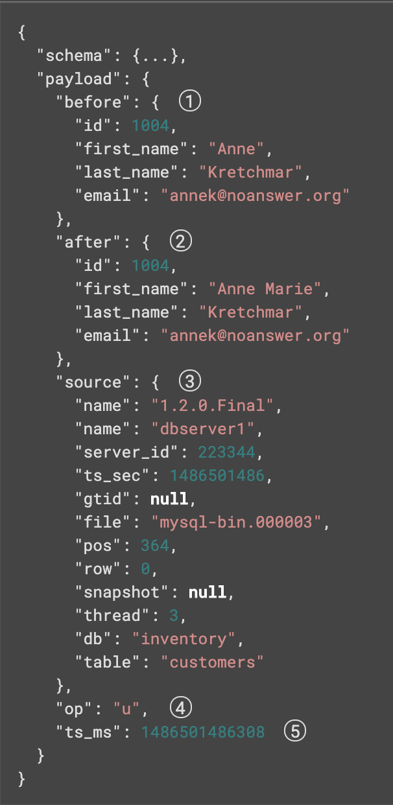
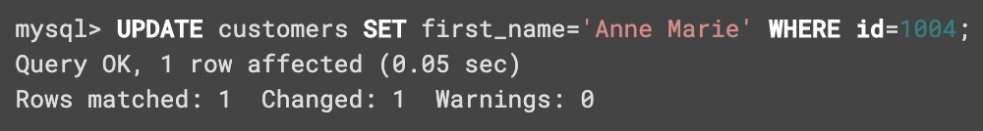
Debezium Change Event
Notes:
Example of an UPDATE event on a MySQL database.

Slide 17
Conclusion
Advantages of Microservices
Challenges with using shared databases
Domain Driven Data Ownership
Centralized Streaming Platform with a Distributed Log
Scalable
Retentive & Re-playable
Autonomous services
Change Data Capture with Debezium
Notes:
Debezium is a set of distributed services to capture changes in your databases so that your applications can see those changes and respond to them.
Debezium records all row-level changes within each database table in a change event stream, and applications simply read these streams to see the change events in the same order in which they occurred.
Debezium is a distributed system that captures all changes in multiple upstream databases, and will never miss or lose an event.
Of course, when the system is operating nominally or being administered carefully, then Debezium provides exactly once delivery of every change event. However, if a fault does happen then the system will still not lose any events, although while it is recovering from the fault it may repeat some change events. Thus, in these abnormal situations Debezium (like Kafka) provides at least once delivery of change events.
Change Data Capture (CDC) is a solution that captures change events from a database transaction log (or equivalent mechanism) and forwards those events to downstream consumers. CDC ultimately allows application state to be externalized and synchronized with external stores of data.
Change Data Capture implementations usually have these characteristics:
External process that reads the transaction log of a database with the goal to materialize change events from those transactions
Change events are forwarded to downstream consumers as messages

Slide 18
Notes:
https://debezium.io/blog/2020/02/10/event-sourcing-vs-cdc/#:~:text=Event%20Sourcing%20uses%20its%20own,presented%20later%20in%20this%20article.
https://www.confluent.io/blog/data-dichotomy-rethinking-the-way-we-treat-data-and-services/
https://martinfowler.com/articles/data-monolith-to-mesh.html#SiloedAndHyper-specializedOwnership
https://martinfowler.com/eaaDev/EventSourcing.html

